Slide 1
Microprocessor Control Logic – 1 ALU Instructions A microprocessor’s control logic can be thought of as the control centre of the microprocessor. The task in this assignment is to design the control logic, which is essentially a finite state machine

Slide 2
The control logic is to be designed for a 16-bit microprocessor whose other parts, an ALU, register file, and PC were designed in previous assignments.
These modules have been instantiated inside a bigger module called mproc, which represents the microprocessor
The module called ir which implements the instruction register is also instantiated inside mproc
The module called control_logic, contents of which have to be written to complete this assignment.
Modules instantiated inside mproc have been connected together as discussed in class for the microprocessor to function

Slide 3
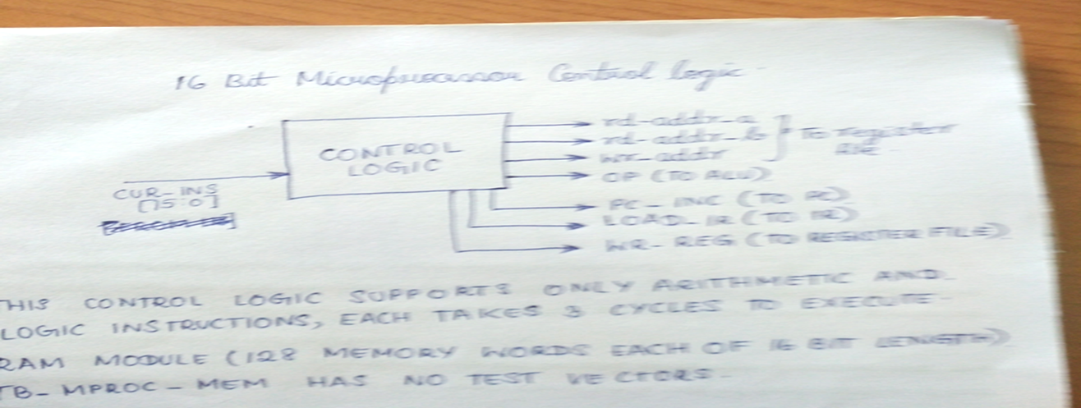
The input to the control_logic is
cur_ins (the instruction stored in ir)
It’s outputs are
rd_addr_a
rd_addr_b
wr_addr (read and write port addresses to the reg_file),
op (alu operation)
pc_inc(to pc)
load_ir(to ir)
wr_reg( to reg_file)
The pc_inc,load_ir,wr_reg signals need to come from the FSM to be implemented within control_logic,
rd_addr_a,rd_addr_b,wr_addr signals need to be derived (in a straightforward manner) from the cur_ins input.

Slide 4
In this assignment the control logic needs to support no load/store or jump instructions but only arithmetic and logic instructions, each of which requires three clock cycles to execute.
In the first cycle (fetch) the instruction address is supplied to external memory and the instruction is fetched from memory.
In the second cycle (decode/execute), the instruction is stored in ir, decoded and executed by the alu, and its output stored in reg_file.
In order to do so, a memory module called ram_128_16 has been provided that implements 128 memory words each of 16-bit length.
The memory is connected to the microprocessor in the module mproc_mem.

Slide 5
mproc_mem only has two inputs (clk and reset) and no outputs so when it is instantiated inside the supplied testbench tb_mproc_mem, there is no way to supply test vectors.
So to enable testing, the first few locations of ram_128_16 have been initialized with a few instructions, which the microprocessor (with correct control_logic) will start fetching and executing, enabling testing of the implemented logic.
For further testing, more instructions can be added to initial block of the ram_128_16 module.

Slide 6
Each instruction is 16-bits and has the format shown in figure 1.
Figure 1: Format of arithmetic and logic instructions.
Since only the four arithmetic and logic instructions are being implemented, the registers in the register file, which are all initialized to 0, cannot be loaded with arbitrary values. So a peculiar problem arises because each above instruction will output 0 if its inputs are 0.
So in order to have non zero register values (to test proper instruction execution) register 0 is initialized to 16’hffff.

Slide 7
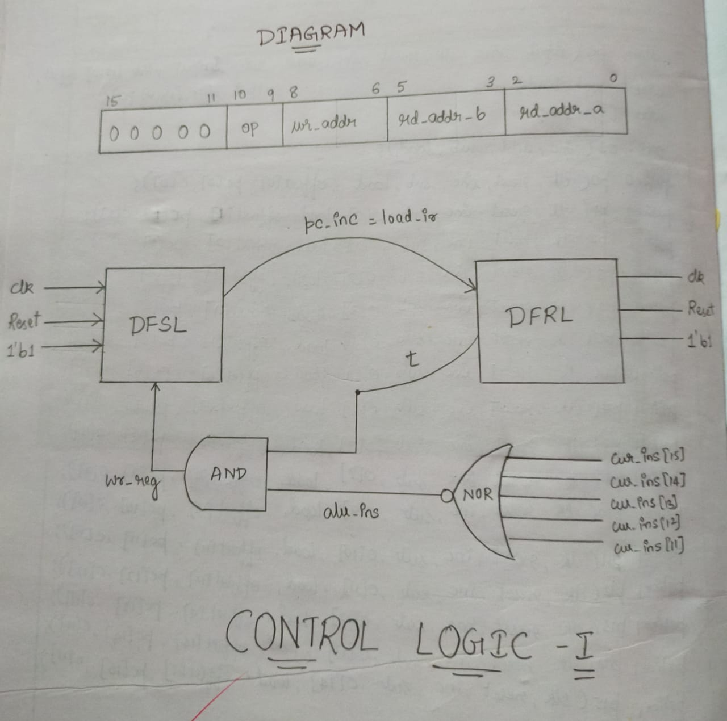

Slide 8
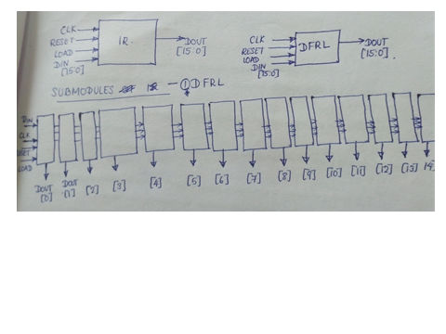
mproc.v Module 1
module ir (input wire clk, reset, load, input wire [15:0] din, output wire [15:0] dout);
dfrl dfrl_0 (clk, reset, load, din['h0], dout['h0]);
dfrl dfrl_1 (----------------------------);
dfrl dfrl_2 (----------------------------);
dfrl dfrl_3 (--------------------------------);
dfrl dfrl_4 (-----------------------------);
dfrl dfrl_5 (----------------------------);
dfrl dfrl_6 (--------------------------);
dfrl dfrl_7 (--------------------------);
dfrl dfrl_8 (--------------------------);
dfrl dfrl_9 (--------------------------);
dfrl dfrl_a (---------------------------);
dfrl dfrl_b (---------------------------);
dfrl dfrl_c (-------------------------------);
dfrl dfrl_d (----------------------------);
dfrl dfrl_e (---------------------------);
dfrl dfrl_f (-------------------);
endmodule

Slide 9
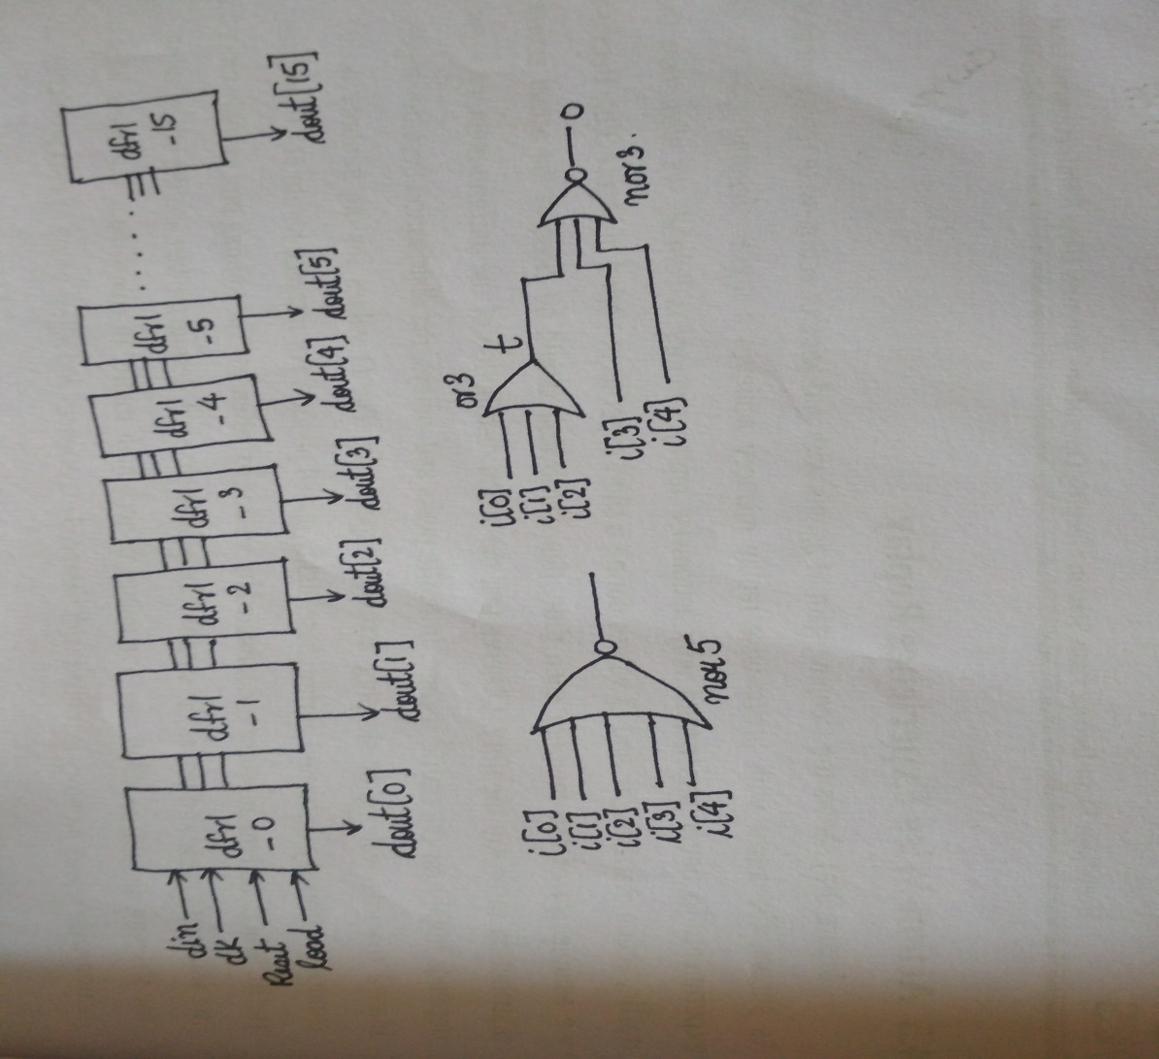
mproc.v Module 2
module nor5 (input wire [0:4] i, output wire o);
wire t;
or3 or3_0 (---------------------);
nor3 nor3_0 (-----------------------);
endmodule

Slide 10
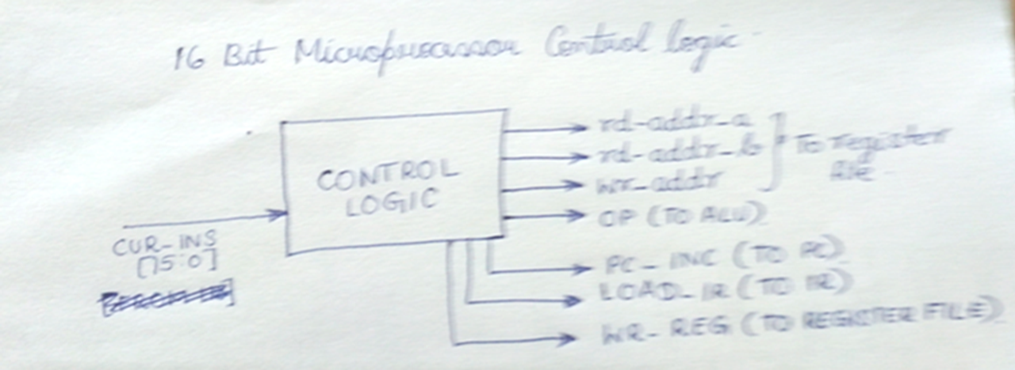
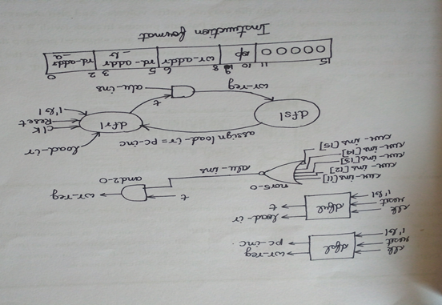
mproc.v Module 3
module control_logic (input wire clk, reset, input wire [15:0] cur_ins, output wire [2:0] rd_addr_a, rd_addr_b, wr_addr, output wire [1:0] op, output wire pc_inc, load_ir, wr_reg);
wire t, alu_ins;
dfsl fetch (-----------------------------------);
assign load_ir=pc_inc;
dfrl dec_exec (---------------------------------);
nor5 nor5_0 (--------------------------------------);
and2 and2_0 (-------------------------------------);
assign rd_addr_a = cur_ins[2:0];
assign rd_addr_b = ------;
assign wr_addr = ----------;
assign op = --------------;
endmodule

Slide 11
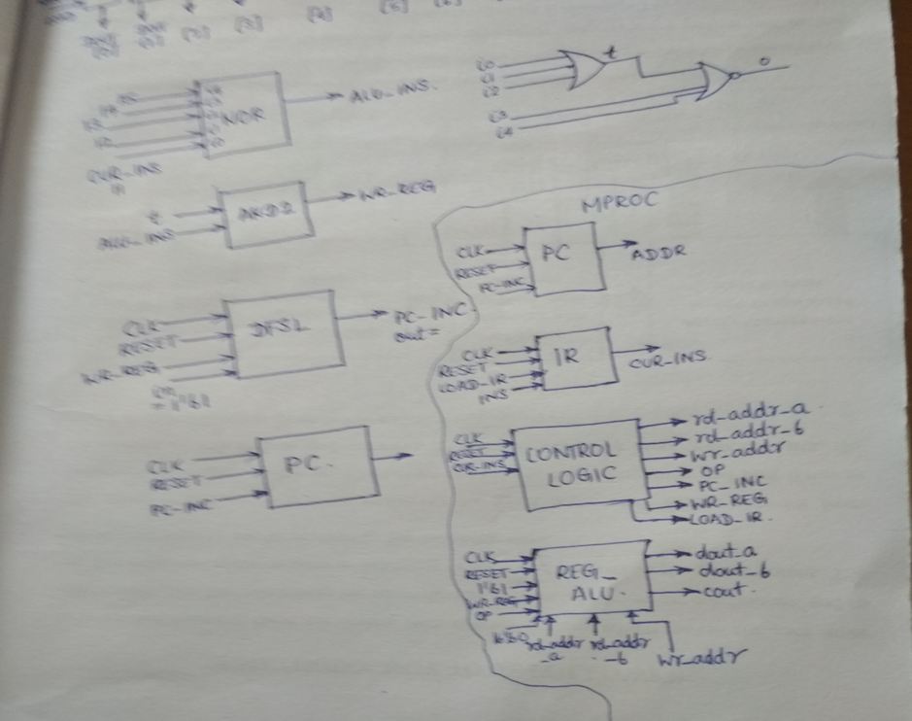
mproc.v Module 4
module mproc (input wire clk, reset, input wire [15:0] ins, output wire [15:0] addr);
wire pc_inc, cout;
wire [2:0] rd_addr_a, rd_addr_b, wr_addr;
wire [1:0] op;
wire [15:0] cur_ins, d_out_a, d_out_b;
pc pc_0 (------------------------);
ir ir_0 (------------------------------);
control_logic control_logic_0 (--------------------------------------);
reg_alu reg_alu_0 (------------------------------------------------);
endmodule

Slide 12
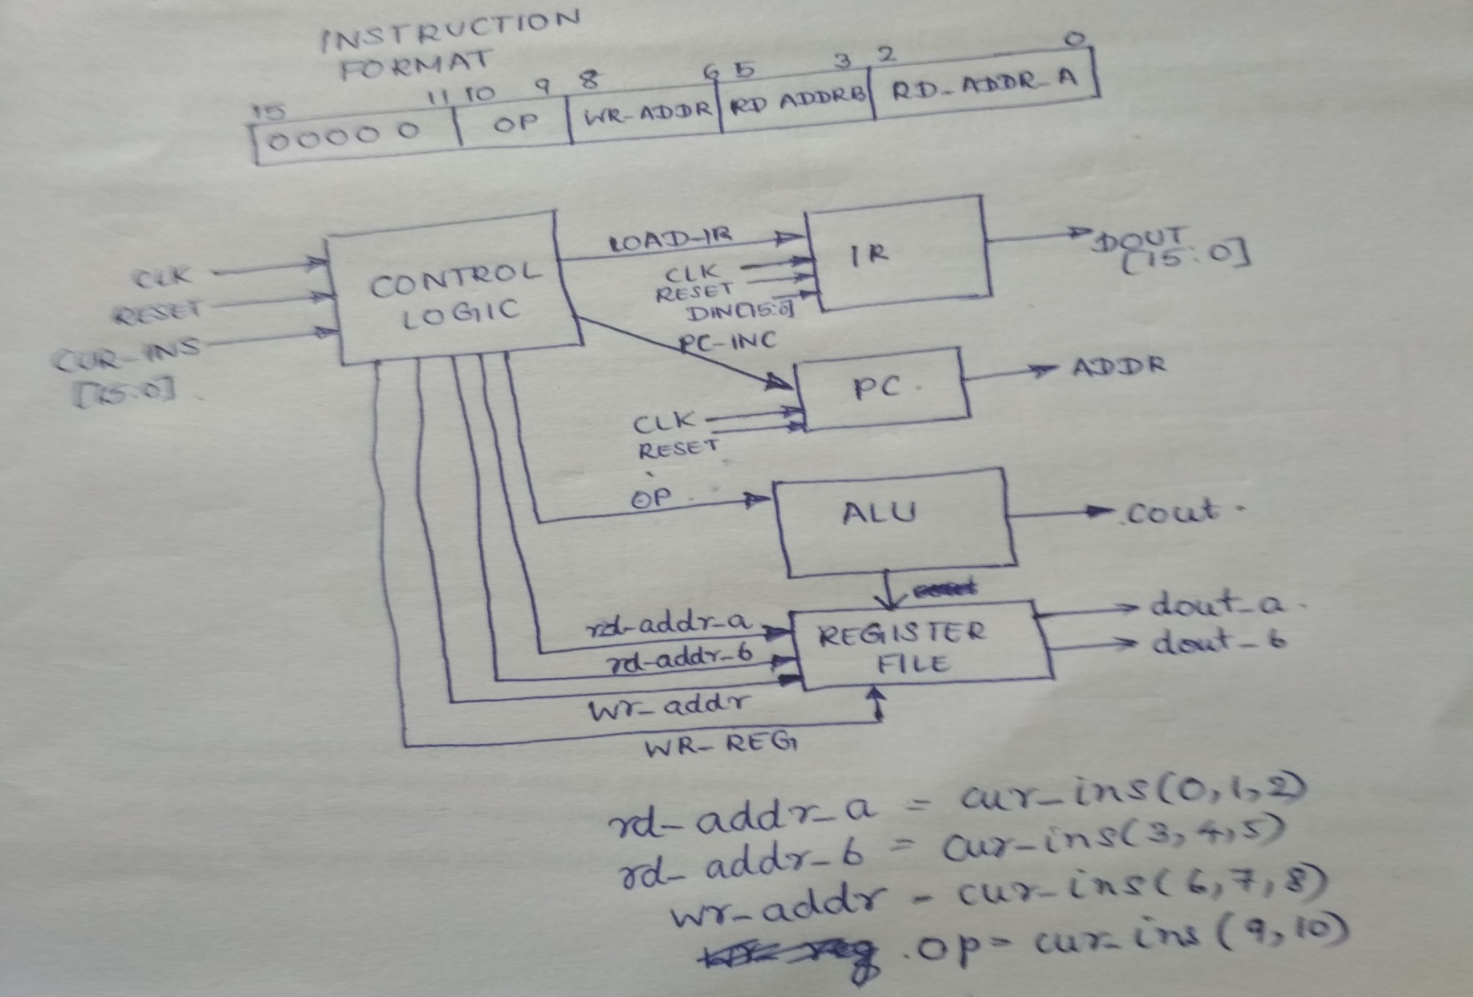
Overall View of mproc.v

Slide 13
mproc_mem.v Module1
module ram_128_16 (input wire clk, reset, wr, input wire [6:0] addr, input wire [15:0] din, output wire [15:0] dout);
reg [0:127] ram [15:0];
initial
begin
ram[0]=16'o000100;
ram[1]=16'o001201;
ram[2]=16'o002321;
ram[3]=16'o003432;
end
always @(wr)
ram[addr]=din;
assign dout=ram[addr];
endmodule

Slide 14
mproc_mem.v Module 2
module mproc_mem (input wire clk, reset);
wire [15:0] addr;
wire [15:0] ins;
ram_128_16 ram_128_16_0 (clk, reset, 1'b0, addr[6:0], 16'b0, ins);
mproc mproc_0 (clk, reset, ins, addr);
endmodule

Slide 15
DESIGN AND SIMULATION
iverilog -o tb_mproc_mem lib.v pc.v alu.v reg_alu.v mproc.v mproc_mem.v tb_mproc_mem.v
vvp tb_mproc_mem
gtkwave tb_mproc_mem.vcd

Slide 16
cur_ins [15:0] | ram | Octal Value Of cur_ins | 15 | 14 | 13 | 12 | 11 | 10 | 9 | 8 | 7 | 6 | 5 | 4 | 3 | 2 | 1 | 0
0040 (Hex) | ram [0] | 16‘o 000100; | 0 | 0 | 0 | 0 | 0 | 0 | 0 | 0 | 0 | 1 | 0 | 0 | 0 | 0 | 0 | 0 | d_out_a+ d_out_b= FFFF+FFFF =FFFE with carry =1
0281 (Hex) | ram [1] | 16'o 001100; | 0 | 0 | 0 | 0 | 0 | 0 | 1 | 0 | 1 | 0 | 0 | 0 | 0 | 0 | 0 | 1 | d_out_a- d_out_b= FFFE-FFFF =FFFF with borrow=1
04D1 (Hex) | ram 2] | 16'o 002100 | 0 | 0 | 0 | 0 | 0 | 1 | 0 | 0 | 1 | 1 | 0 | 1 | 0 | 0 | 0 | 1 | d_out_a AND d_out_b= FFFE AND FFFF=FFFE
071A (Hex) | ram [3] | 16'o 003100; | 0 | 0 | 0 | 0 | 0 | 1 | 1 | 1 | 0 | 0 | 0 | 1 | 1 | 0 | 1 | 0 | d_out_a OR d_out_b= FFFF OR FFFE=FFFF

Slide 17
